Slide 1

Wanting and Liking in Human Ventral Striatum
Project

Slide 2
Concepts Operationalization
Animals
Humans
Reward Processing
Wanting
Effort before
PIT
Human-PIT
Liking
Pleasure during
Orofacial expressions
Hedonic experience
Berridge & Robinson (2003). Trends in Neuroscience

Slide 3
Human PIT with odors
PIT with Monetary Reward
PIT with Olfactory Reward
Talmi et al., (2008). Journal of Neuroscience

Slide 4
Human PIT with odors
Pavlovian with Monetary Reward
Pavlovian with Olfactory Reward
Talmi et al., (2008). Journal of Neuroscience

Slide 5
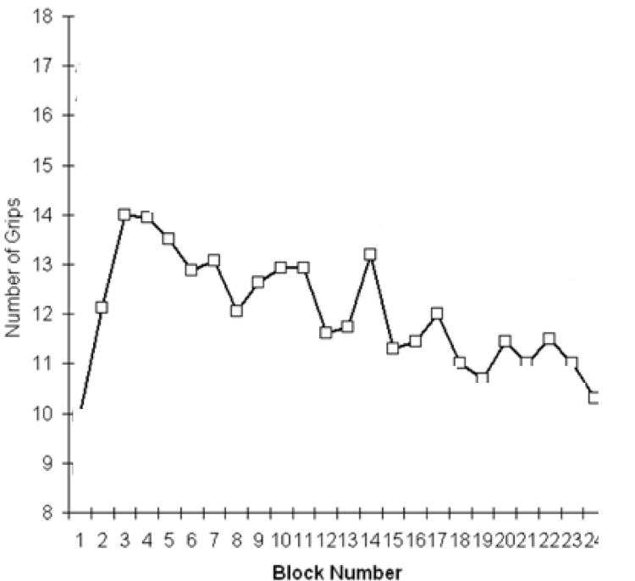
Human PIT with odors
Instrumental with Monetary Reward
Instrumental with Olfactory Reward
Talmi et al., (2008). Journal of Neuroscience

Slide 6
Human PIT with odors
Transfer with Monetary Reward
Transfer with Olfactory Reward
Talmi et al., (2008). Journal of Neuroscience

Slide 7
Neural Networks (VS)
Animals
Humans
Reward Processing
Wanting
Effort before
NAcc
core
NAcc caudal and medial
Liking
Pleasure during
Hotspot NAcc shell
NAcc rostral and lateral
High-resolution
Baliki et al. (2013). Journal of Neuroscience (for human NAcc parceling)

Slide 8
Procedure
Day 1 (outside the scanner)
Check leanings
Select neutral odor and check on chocolate
Familiarity
Intensity

Slide 9
Procedure
Day 2 (in the scanner)
5 min
Reminder + Partial Extinction
PIT (18 trials*CS)
CS+; CS-; Baseline
18 min
Pleasantness
Intensity
18 min
Pleasure (18 trials*odor)
Choco; neutral; Control

Slide 10
Procedure (details)
Day 2 (in the scanner: PIT)
+
+
12 s
4 s
12 s
12 s
12 s
20 s (12 + 8 ITI) per stimulation
Mini blocks of three
6 Mini blocks of 3 for each condition
(CS+ CS- Baseline)
54 stimulations in total

Slide 11
Procedure (details)
Day 2 (in the scanner: odor)
Pleasantness
Pleasantness
Pleasantness
20 s - ?
20 s - ?
20 s - ?
2 s
2 s
2 s
20 s (2 + 18 ITI) per stimulation
Mini blocks of three
6 Mini blocks of 3 for each condition
(chocolate neutral control)
54 stimulations in total

Slide 12
Planned Analysis
PIT
Within
CS+_p
CS-_p
Between
CS+_p
CS-_p
U
Behavioral PIT
Hedonic Pleasure
Within
Chocolate
Neutral
Between
Chocolate
Neutral
U
Behavioral Pleasantness

Slide 13
Planning
Project for Ethical Committee
Behavioral Pilot (N = 10) ??????
?
Extinction ( 6 → 18)
?
2 days Protocol
BBL meeting
Data collection

Slide 14

Thank you for your attention

Slide 15
Procedure (details)
Day 2 (in the scanner: odor)
2.5 s
Open Valve
Close Valve
3
2
1
*
1
*
+
Liking
1
1
+
Intensity
1.5
1
0.8/1.2
+
x
Time (s)
0.5
y
14.5 – (x + y)
Pichon et al., (in prep)

